Slide 2
Overview of SPFX Solution Structure
Prasham Sabadra

Slide 3




Prasham Sabadra
Technical Architect, Tieto India Pvt. Ltd.
Proud Indian.
Passionate SharePoint Techie.
Avid reader, learner.
Blogger, Speaker.
5 consecutive time C# corner MVP
https://knowledge-junction.com/
https://live-beautiful-life.com
Psabadra@gmail.com
/in/prasham-sabadra-8569334/
sabadraprasham
https://www.facebook.com/prasham.sabadra

Slide 4
Creating SPFX component

Slide 5
Tools used to build the SPFX components
Required Tools
Node.js (NPM will be the part of Node.Js installation.)
Gulp
Yeoman
Yeoman SharePoint Generator
Code Editor
Visual Studio Code
Atom
Webstorm
Some optional Tools
Fiddler
Postman
Windows Terminal
Cmder for Windows
GIT

Slide 6
Yeoman
Yeoman is open-source scaffolding tool having lots of plug-ins called generators can be used to scaffold new projects with best practices
Relies on NPM and Gulp
• Scaffolding tool for Modern web apps
Using the Yeoman SharePoint generator, we are able to scaffold new client-side solution projects to build, package, and deploy SharePoint solutions.
• Used as SPFx solution generator and builds required project structure
• ‘yo’ is the command line utility for creation of projects
Install Yeoman
Run the below command (to install globally)
npm install -g yo

Slide 7
Yeoman
To start with SPFX component we must first install respective generator – here SharePoint generator
Yeoman SharePoint generator is available as part of the framework as an npm package
Install Yeoman SharePoint Generator
Run the below command
npm install -g @microsoft/generator-sharepoint
yo @microsoft/sharepoint --help

Slide 8
Creating SPFX Client Side Web Part
We will use Yeoman SharePoint Generator to create the solution as
yo @microsoft/sharepoint
Yeoman generator will start the scaffolding process to create the solution and will install required dependencies.

Slide 9
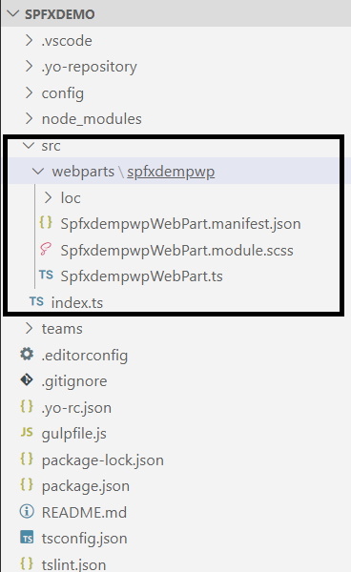
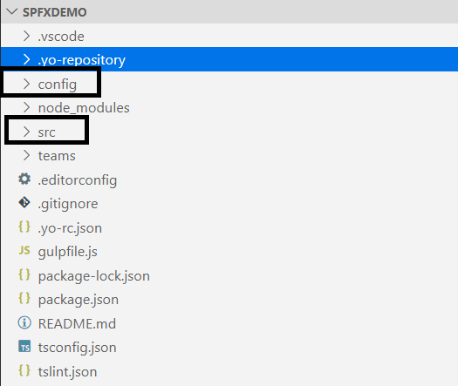
Solution structure
src folder => Place where we add/edit our code files

Slide 10
Webpart class (<WebpartName>.ts file)
Every client side Web Part is derived from BaseClientSideWebPart class
This method is entry point for the Web Part. Which implements render() method – used to render the web part inside the DOM element
This <WebpartName>.ts file resides under “src >> webparts >> <webpart>”
Another important method this class have “getPropertyPaneConfiguration()” which implements interface “IPropertyPaneConfiguration” – In this method we will specify our custom properties.
To have our custom properties we also need to update the interface “I<webpartname>WebPartProps”

Slide 11
WebPart Manifest
<WebPart Name>WebPart.manifest.json file
Contains meta data of web part – id, version, display name, icon and description for the web part
This file is must to have
preconfiguredEntries – This property provides information about the web part to use in web part tool box
ManifestVersion-
Version of the manifest schema
The value of this field is controlled by Microsoft.
Current value must be “2”

Slide 12
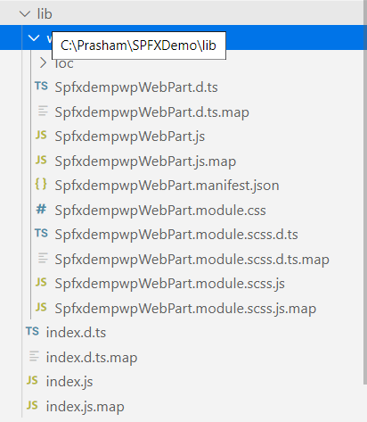
lib folder
Serves as intermediate folder in the build system
Contain the files which are ready to move to the bundle, which is distributed with App
Typescript files are compiled into Java Script files in this folder
.map files are used to support browser debugging

Slide 13

dist folder
Contain the files which are distributed with App
config folder
Contain the collection of JSON files which controls how the app get packaged

Slide 14
Config folder
File | Purpose
config.json | List out the files which are to be included in the bundle including solution components and entry points, external references and localization resources.
package-solution.json | Controls the details of the app package which is produced by gulp package-solution. Here we specify the package file name which we upload to AppCatalog
write-manifests.json | Points the location where the web part bundle is available
deploy-azure-storage.json | This file is used while deploying the client-side web part to Azure CDN. This file contains Azure storage account details.

Slide 15
File | Purpose
Serve.json | This file is used to debug the SPFX extensions on modern pages When we add a new SharePoint Framework extension to our project, the SharePoint Framework Yeoman generator will add a new entry to the config/serve.json file in your project. In the file SharePoint Framework Yeoman generator creates the entry for each extension While debugging to use particular serve configuration, we need to use command gulp serve --config=<name>

Slide 16
Root folder
File | Purpose
gulpfile.js | defines gulp tasks to run
package.json | It defines the JavaScript library dependencies (and their versions) used by our solution
tsconfig.json | defines TypeScript compilation settings
tslint.json | defines TypeScript style checking settings

Slide 17
Few common errors:
webpart.manifests.json – WebPart Id – String does not match the pattern of “^[0-9a-f]{8}-[0-9a-f]{4}-[0-9a-f]{4}-[0-9a-f]{4}-[0-9a-f]{12}$” – webpart id should be in small letters only with matching giving regular expression
SPFX solution deployment error – Component ID {0} exists in solution {1} already. And having some correlation ID.
Make sure that there were no duplicate IDs to the WebParts
Make sure that there were no duplicate IDs to the solution for different solutions in tenant
Make sure that we delete the entries of SPFX components of our solution from “Client Side Component Manifests” list.
error of gulp package –solution: “The webparts manifests list is empty. Please ensure you have done a build and that your config file is pointed at the correct folder” – While bundling –ship attribute is not used
SPFX component all gulp commands failed. Error – JSON validation failed. WebParts\config\tslint.json – tslint.json file location is moved from config folder to root folder

Slide 18
References

Slide 19
Node Js - https://nodejs.org/en/
Configure web part icon
Fluent UI Icons
Simplify adding web parts with preconfigured entries
https://yeoman.io/learning/index.html

Slide 21
Deploying and shipping SPFX solutions
By Vijay Natarajan On 15-April-2020

